Slide 1
BINDT Aerospace workshop – UT TFM for LMDw
Tom Bertenshaw
Principal NDT Research Engineer
Export Control - Technology Uncontrolled data - The documents within this transmission contain NO technical data subject to the "UK Export Control Act 2002 or EU Dual-Use Regulation (Council Regulation (EC) No 428/2009), as amended. Export Classification: NSR

Slide 2
BINDT Aerospace workshop – UT TFM for LMDw
Presentation Content
Overview of Research project
Previous work
Gaps / Issues
Planned tests
Outcome
Ongoing work and Future work
Legally privileged and confidential

Slide 3
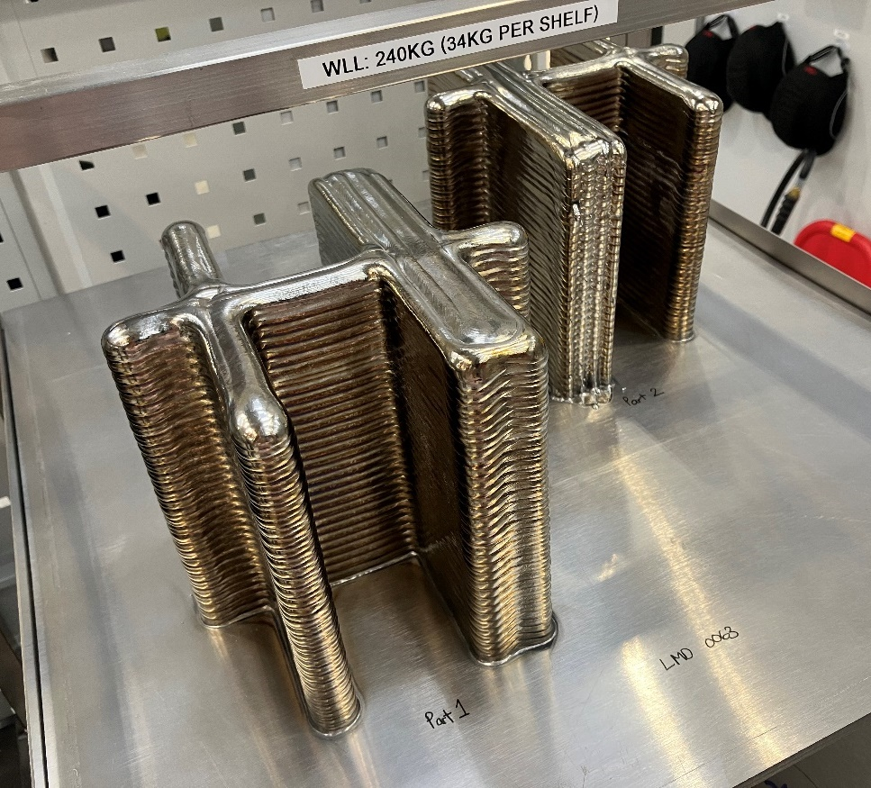
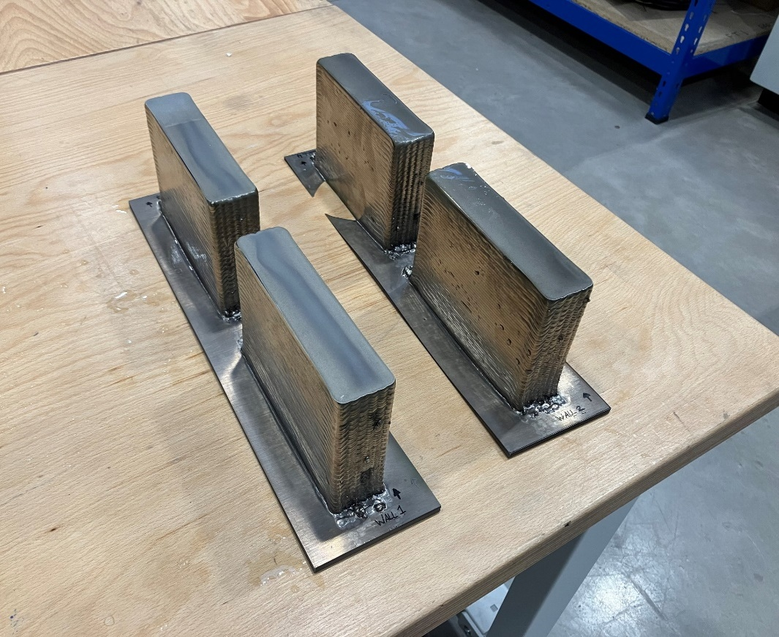
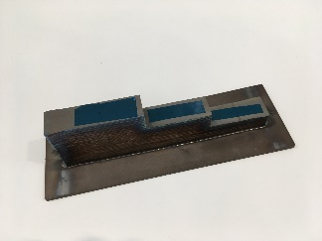
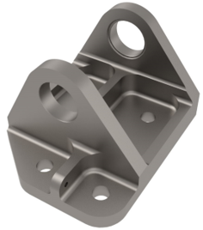
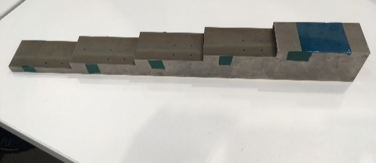
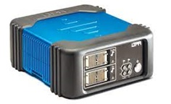
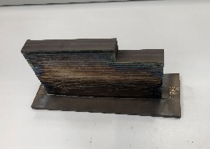
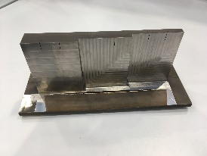
BINDT Aerospace workshop – UT TFM for LMDw
Overview of Research Project:
No NDT inspection processes has yet been developed for LMDw parts, which meets the inspection criteria.
My role has been to implement a new inspection process using the “Total Focusing Method” (TFM), initially for TRL accreditation but ultimately to support part qualification.
The goal was to demonstrate inspection capability for a Ti64 aerospace bracket, manufactured by LMDw to TRL5 maturity
H-Sections
Fatigue walls
Timeline
2020 |  |  |  | 2021 |  |  |  | 2022 |  |  |  | 2023 |  |  |  | 2024 |  |  |  | 2025
Exploratory NDT work begins
Prep for TRL5 starts
TRL3 passed
Lit review
TRL4 passed
TRL5
NDT activities paused
Today
Equipment procurement
Legally privileged and confidential

Slide 4
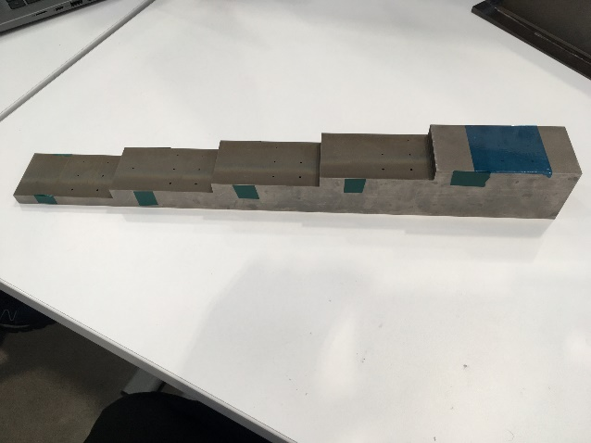
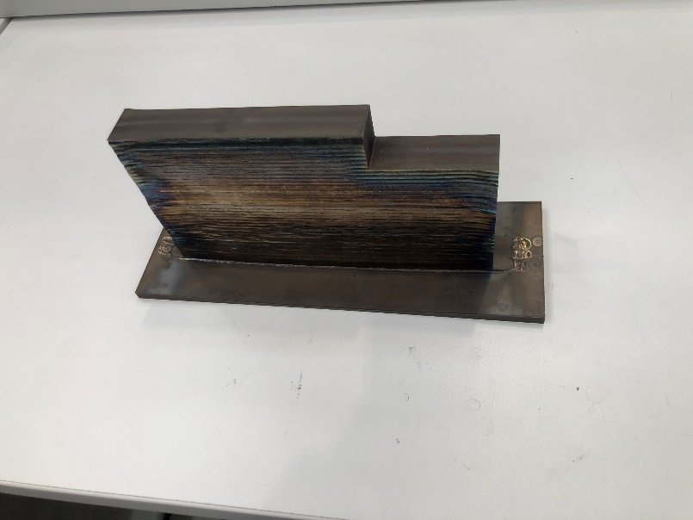
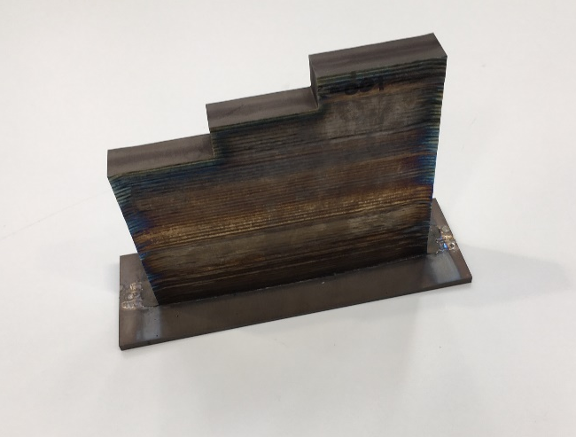
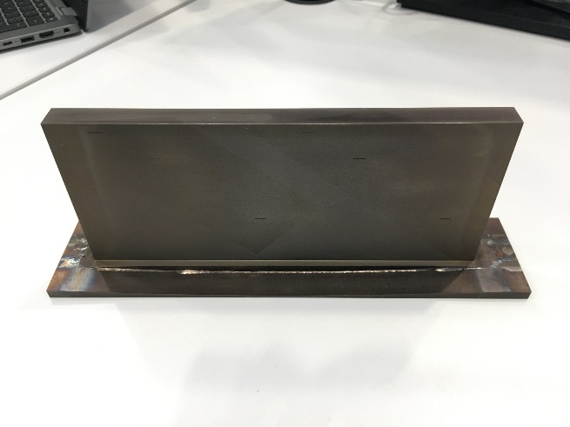
LMDw: NDT technique development for TRL4
Previous work - Test Plan
Test blocks manufactured from LMDw Ti walls
Inspection from baseplate
use standard Pulse Echo Phased Array
Use FMC/TFM technology (2D encoded)
direct wall inspection
use standard Pulse Echo Phased Array
Longitudinal & Shear wave techniques
Through Transmission
Artificial Defects:
Spherical bottomed holes
Flat bottomed holes
EDM notch defects
Scan time / Setup time
Test Blocks
Stepped blocks PE FMC/TFM inspection from baseplate
Inspection from web
Use PAUT, Shear wave and TT inspection techniques
SBH and EDM notch defects
Export Classification - NSR
Legally privileged and confidential
Notes:
Test blocks manufactured from LMDw Ti walls will look at different ways of inspecting these components.
It will also assess different ways of detecting defects at different orientations
Defects can take many forms – some literature has shown it is possible to create cracks parallel to the web surface
Spherical bottomed holes were used in these stepped blocks (as indicated by red boxes)
They are the most difficult to image
Representative of voids

Slide 5
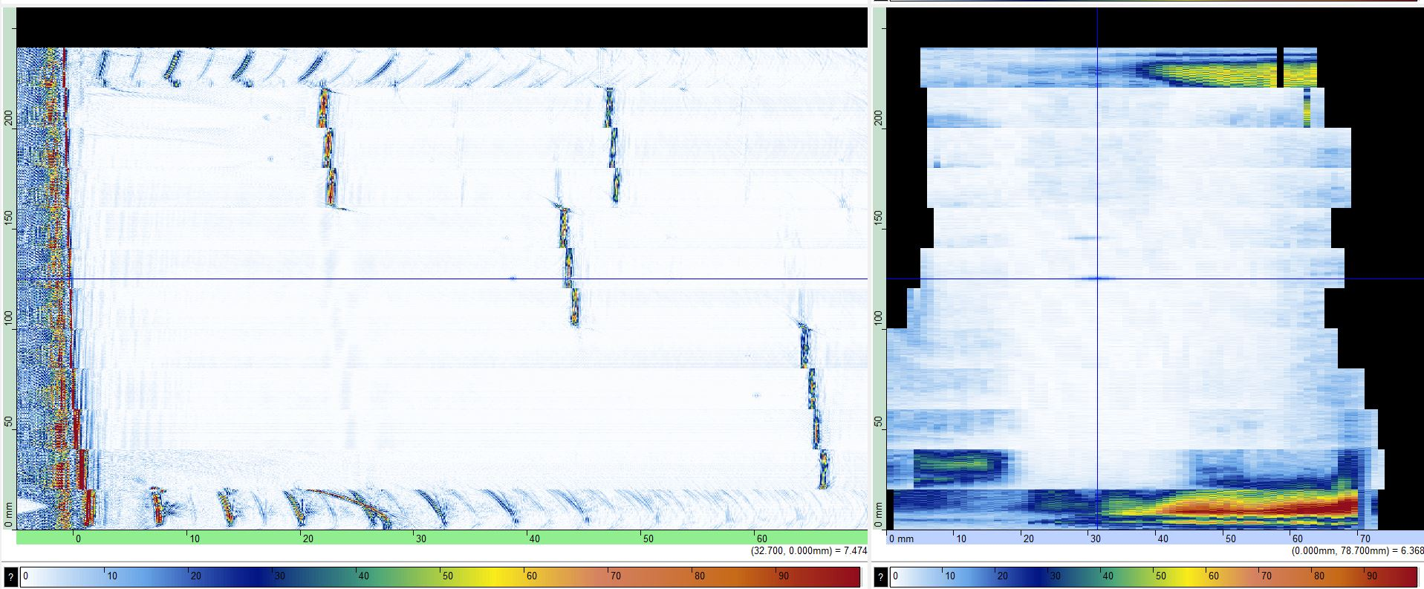
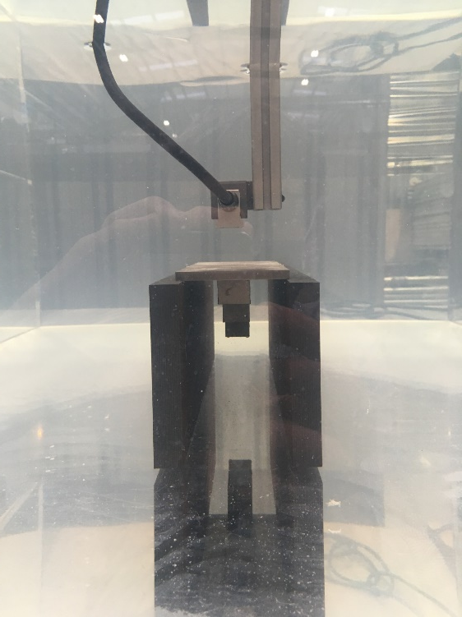
LMDw: NDT technique development for TRL4
Previous work - Results
Defect Detection with TFM using stitched scans
B-scan
C-scan gated around defect on second step
Export Classification - NSR
Legally privileged and confidential
Notes:
Notes:
There are small improvements required
Slight misalignment in B-scan is to small change in probe offset (1-2mm)

Slide 6
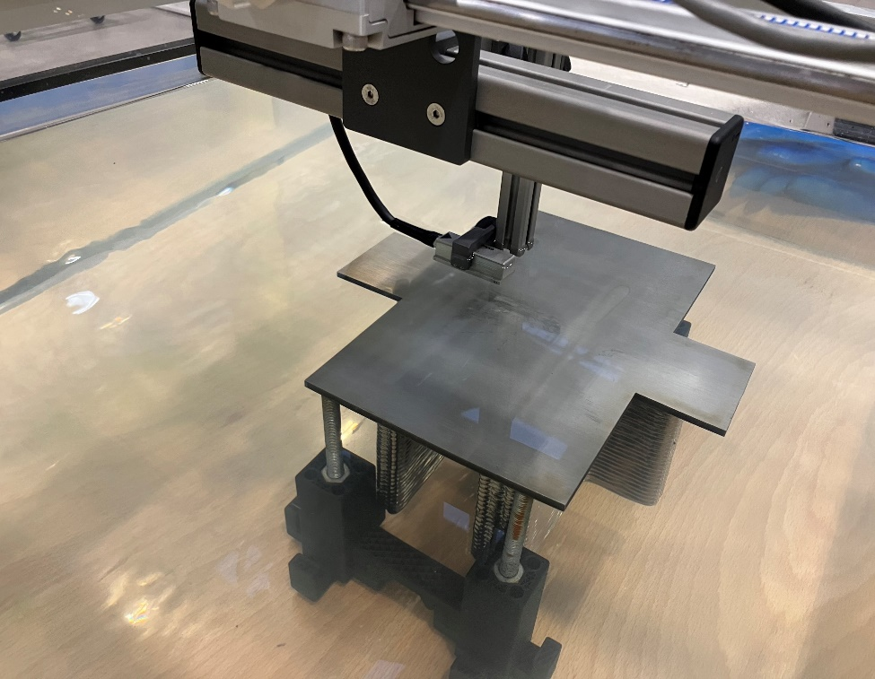
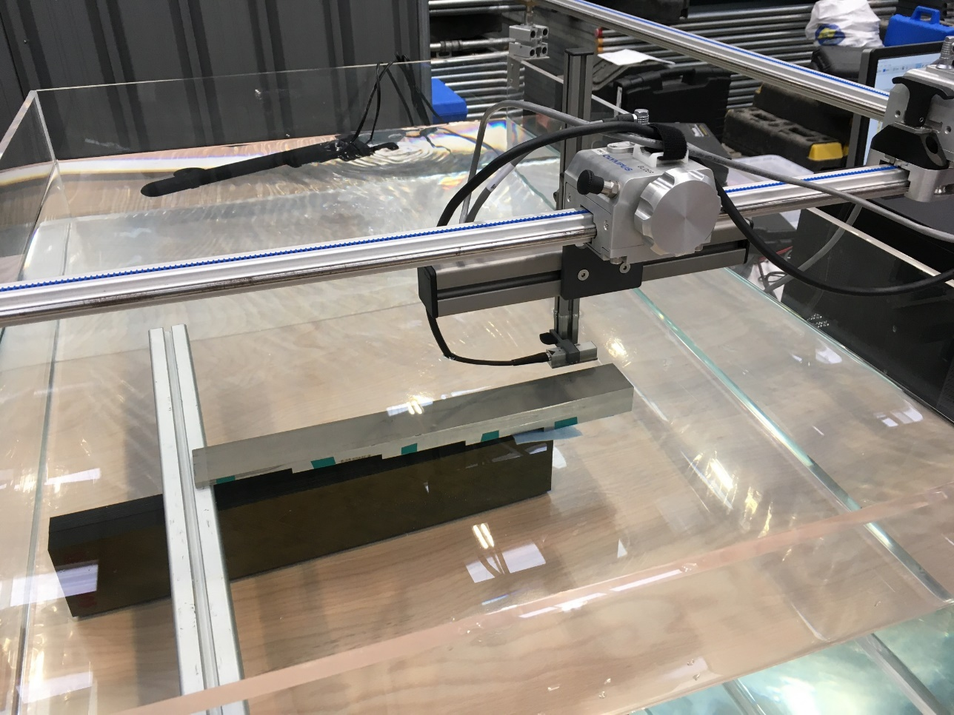
LMDw: NDT technique development for TRL4
Previous work – conclusions from tests
Principle technique used was longitudinal Pulse Echo FMC/TFM inspection from the bottom of the baseplate
Test blocks are similar to those described in AMS-STD-2154E
Use of TFM stitched scans
Preferred scan orientation / test setup
Other observations
Effect of component distortion
Effect of grain boundary noise
Scan orientation
Probe alignment, probe offset and velocity correction – critical parameters for TFM in a scanning tank
Speed of System for FMC/TFM acquisition
Export Classification - NSR
Legally privileged and confidential

Slide 7
BINDT Aerospace workshop – UT TFM for LMDw
Gaps & Issues
Component distortion and misalignment
Standard compliance – standards that are meant for wrought components can guide test block definition
Coverage – For deep/high walls, another means is needed to inspect the walls: Use shear waves from the side
Detectable defect size: GKN M&P require smaller defects to be found to show we can meet HCF properties
Waterpath can vary due to component alignment and distortion
Region of inspection
Defect characterisation
Shear wave inspection from side wall (machined)
Lack of fusion type defects
Void / pore defect
TFM inspection from baseplate
Legally privileged and confidential

Slide 8
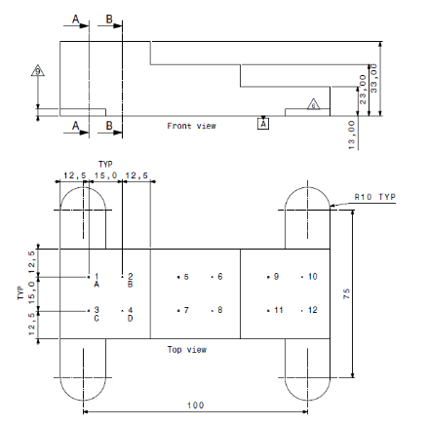
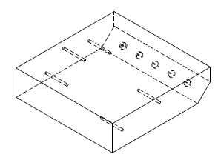
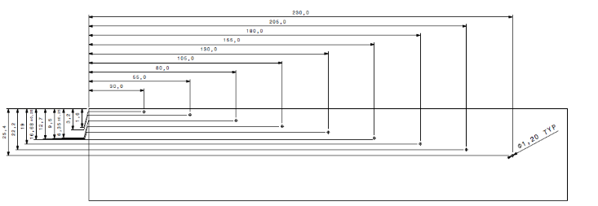
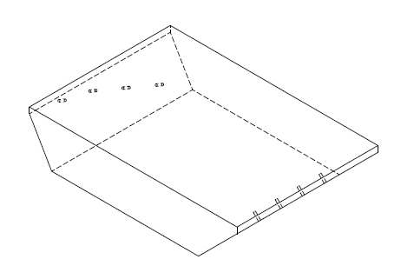
BINDT Aerospace workshop – UT TFM for LMDw
Planned tests
Manufacture of updated longitudinal wave test blocks:
Flat bottomed holes (ASTM E127 compliance)
Hole sizes Ø0.8mm, Ø0.6mm, Ø0.4mm & Ø0.3mm
Design and manufacture of shear wave blocks:
Manufacture IOW AMS 2154E
Different blocks recommended for area amplitude calibration and Distance amplitude calibration
Characterisation of real defects vs FBHs in test blocks
Shear wave block iaw AMS2154E – area amplitude cal
DAC block of similar design for 2 angles
Legally privileged and confidential

Slide 9
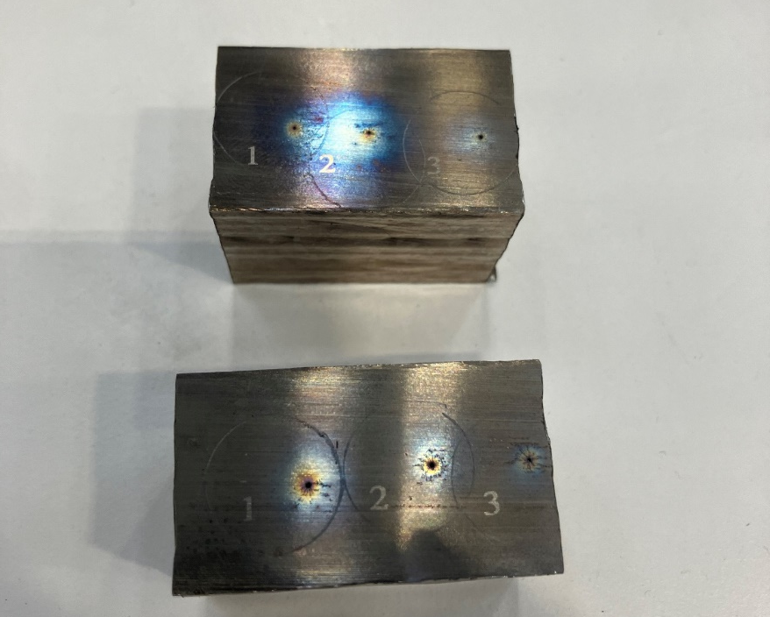
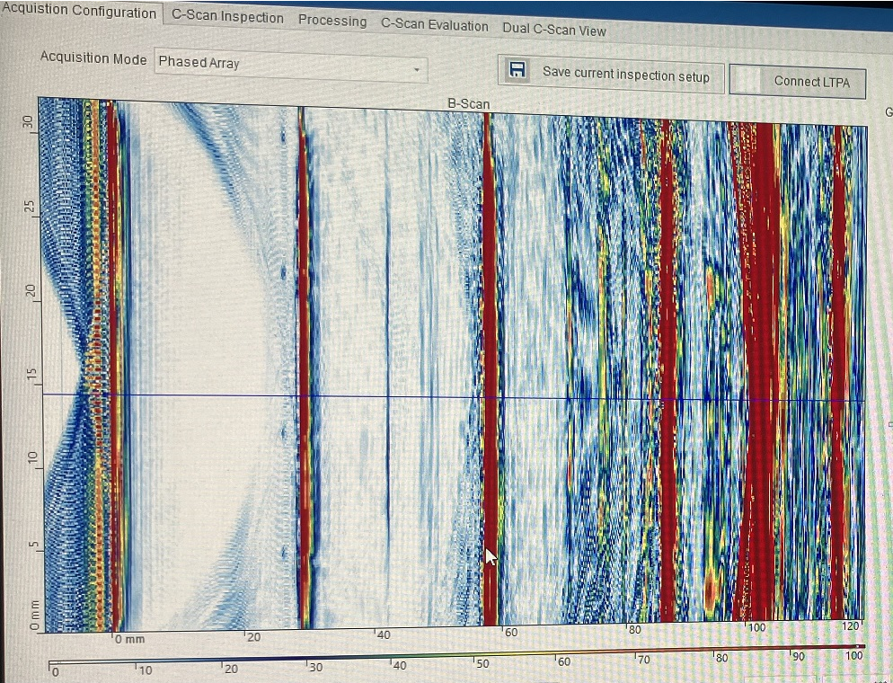
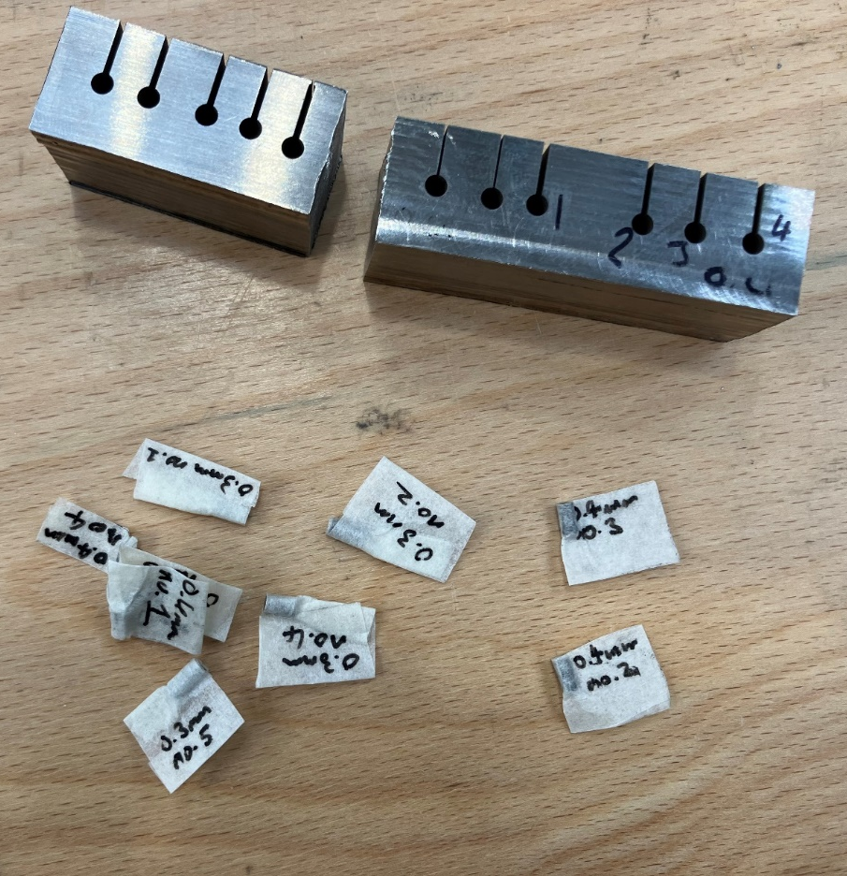
BINDT Aerospace workshop – UT TFM for LMDw
Outcome - longitudinal wave blocks
Drilling 0.3mm & 0.4mm holes has been problematic – EDM drilling has not worked.
Machining using a high speed spindle – acceptable results
Awaiting X-ray CT results
Legally privileged and confidential

Slide 10
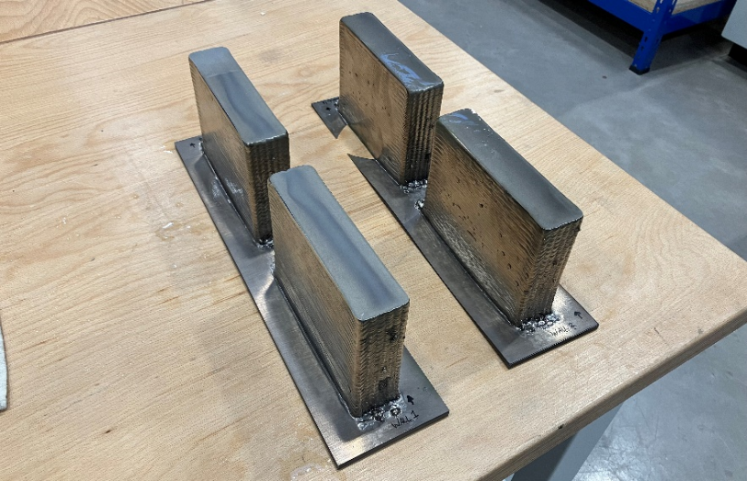
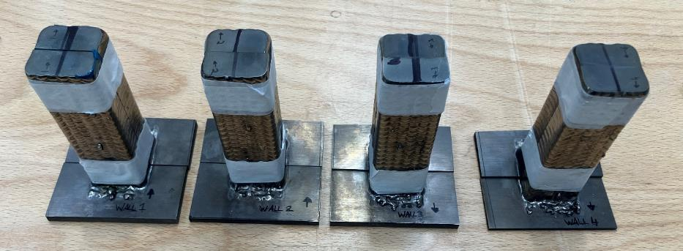
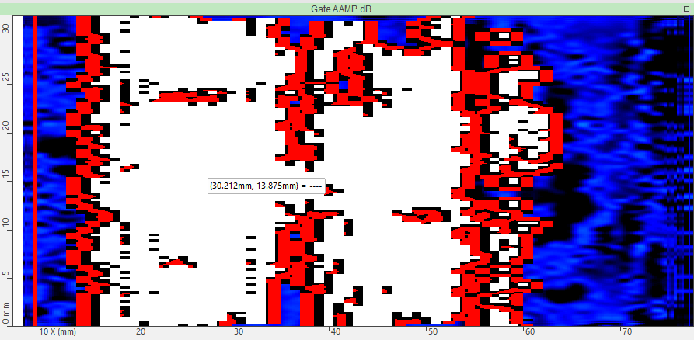
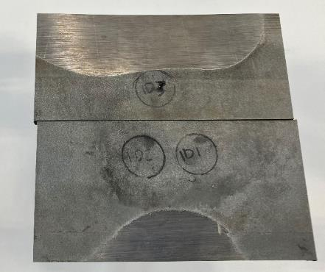
BINDT Aerospace workshop – UT TFM for LMDw
Validation of UT with X-ray CT data
We took some start/stop regions from the fatigue walls
The ends were inspected in the immersion tank and all data captured. Measurements of % amplitude were made
The defects were isolated marked out using a single crystal probe and cut out of the block into small Ti64 cylinders
Waterpath can vary due to component alignment and distortion
Legally privileged and confidential

Slide 11
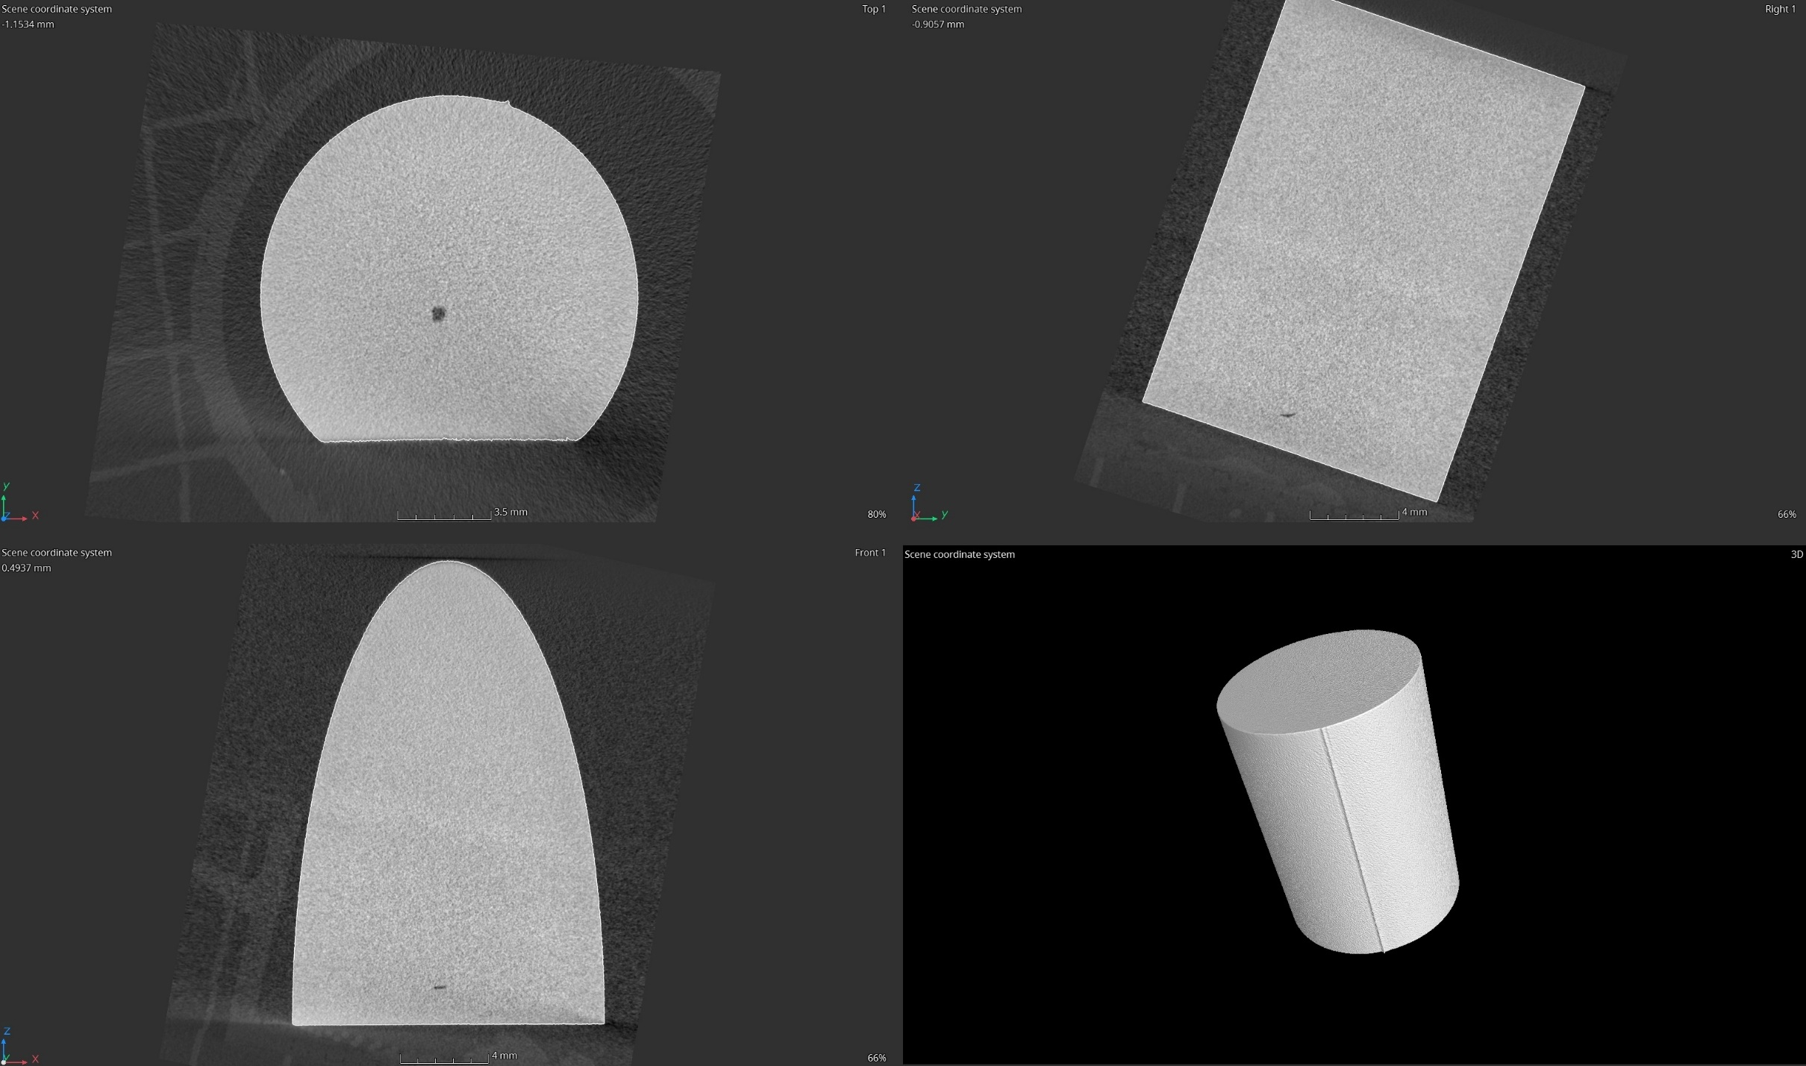
BINDT Aerospace workshop – UT TFM for LMDw
Validation of UT with X-ray CT data
The Ti cylinders were inspected using the X-ray CT machine currently available to GKN Trollhattan in the PTC centre
We were able to distiguish between LOF and porosity defects and the angle of LOF defects
X-ray CT reconstruction of Defect ID1
Legally privileged and confidential

Slide 12
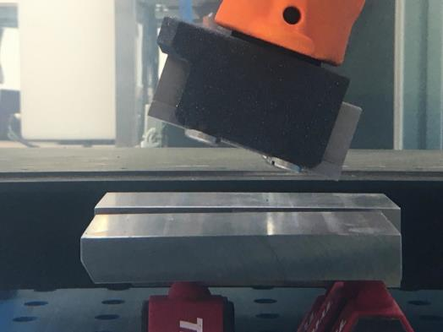
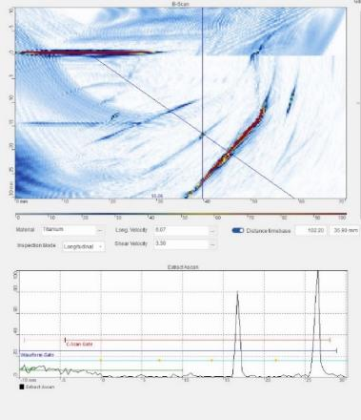
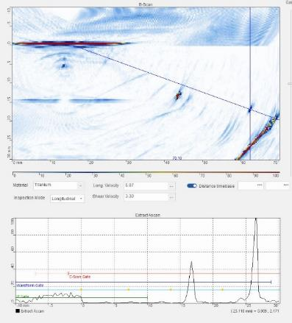
BINDT Aerospace workshop – UT TFM for LMDw
Shear wave test block characterisation
Current test blocks for Flat Bottomed Holes (FBHs) look to use ASTM E127 (see section 8.2.3). This doesn’t cover angle beam inspection of FBHs. It refers AMS 2154E in this case.
Images right are inspections made from 45 degree block defined in ASTM 2154E (see figure 4). It only Area Amplitude Calibration
There is work to be done to understand the different sensitivity of the ROI.
The same flaw in B-scan images right have different amplitude with respect to its position from the index point.
BS ISO 23865 could give guidance on this calibration
AMS 2154E angle block with FBHs (60° block shown)
FBHs on this face
Shear wave inspection – flaw at 55°
Shear wave inspection – flaw at 70°
Legally privileged and confidential

Slide 13
BINDT Aerospace workshop – UT TFM for LMDw
Ongoing work
Complete testing on longitudinal and shear wave setups once test blocks have been created
Update the inspection procedure with view to demonstrate sizing for 0.3 & 0.4mm defects
Future work
Part placement for repeatability - Scanning tank encoder upgrades
Permanent fixtures for calibration blocks mounted in tank
Improved fixturing to hold parts under test
Standards development
Legally privileged and confidential

